Slide 1
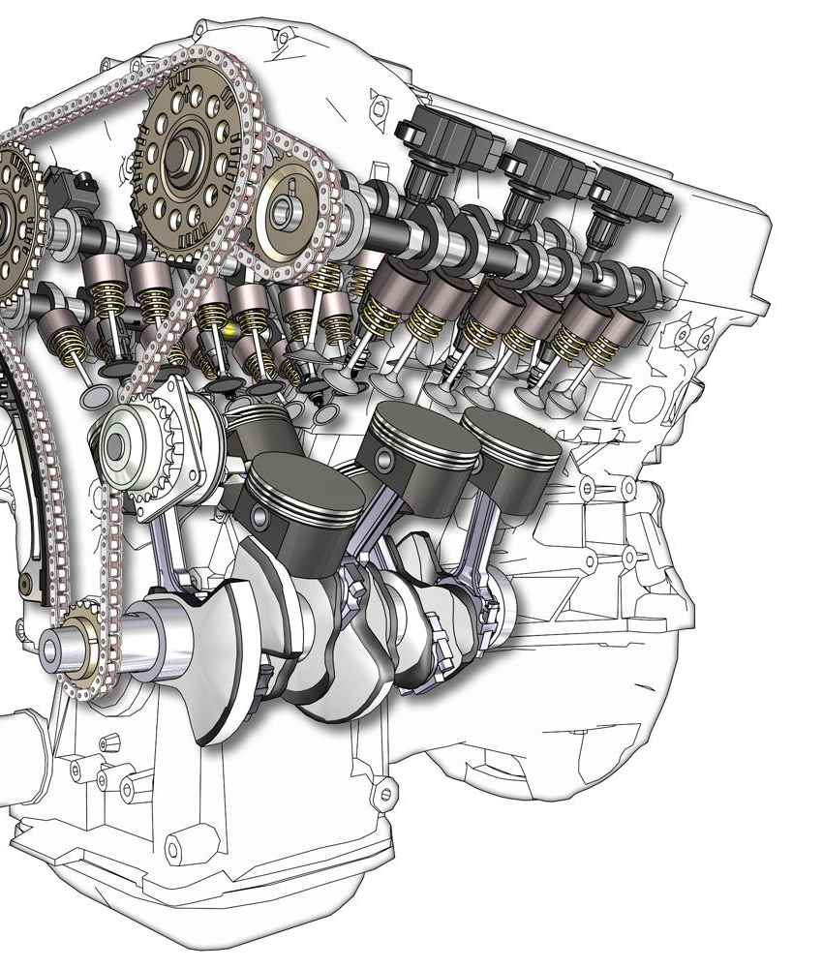
EXPERIMENTAL INVESTIGATION OF BIO-DIESEL IN HCCI ENGINE
GUIDE:
Mrs. ANJANI DEVI SANIPINA,
Assistant Professor
E VIKAS 19A91A0369
M DURGAPRASAD 19A91A0393
V S S MANOHAR 19A91A03B2

Slide 2
ABSTRACT:
Homogeneous Charge Compression Ignition (HCCI) is the new approach to get high brake thermal efficiency and to minimize NOx emissions and smoke. By using this we can get higher rate of homogeneous A/F mixture as compared to compression ignition (CI) engine. One of the advantages of HCCI engine to operate with a wide range of fuels including gasoline, biodiesels and Hydrogen. The lemongrass oil was produced by Steam distillation method and lemon grass oil is blended with diesel fuel with various proportions like B20 + 3 LPM H2 , B20 + 6 LPM H2, B20 + 9 LPM H2. In the current research the use of lemon grass oil mixed with diesel and these results its compared with base reading. The use of biofuels was considered as to reduce pollutant emissions like NOx, CO, HC and smoke.
The viscosity and density of lemon grass oil blend are somewhat similar with diesel fuel. In additional to investigate the characteristics of the lemon grass oil like (FTIR, GCMS and UV Spectro).

Slide 3
INTRODUCTION:
Homogeneous Charge Compression Ignition (HCCI) is a form of internal combustion in which well-mixed fuel and oxidiser (typically air) are compressed to the point of auto-ignition. As in other forms of combustion, this exothermic reaction releases energy that can be transformed in an engine into work and heat.
In recent times crude oil depletion and emission norms are the main challenges to automotive industries.
In order to overcome the challenge, Homogeneous charge compression ignition HCCI engine is the one of the best advanced combustion method to reduce engine emissions
By using HCCI engine gives hybrid thermal efficiency like CI engine and low Oxides of Nitrogen (NOx) and soot emissions like SI engine
it is operated on lean homogeneous air-fuel mixture which reduces NOx and soot emissions

Slide 4
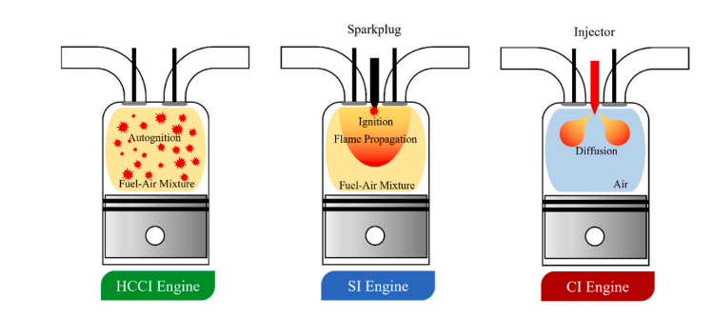

The modification of diesel engine to HCCI engine is a significant milestone which applies the benefits of both petrol engine's principle for homogeneous fuel mixture entry to cylinder chamber and diesel engine's principle for high compression auto-ignition of the fuel mixture.
Fig. HCCI Engine
Fig . HCCI engine working
Tuesday, September 17, 2024

Slide 5
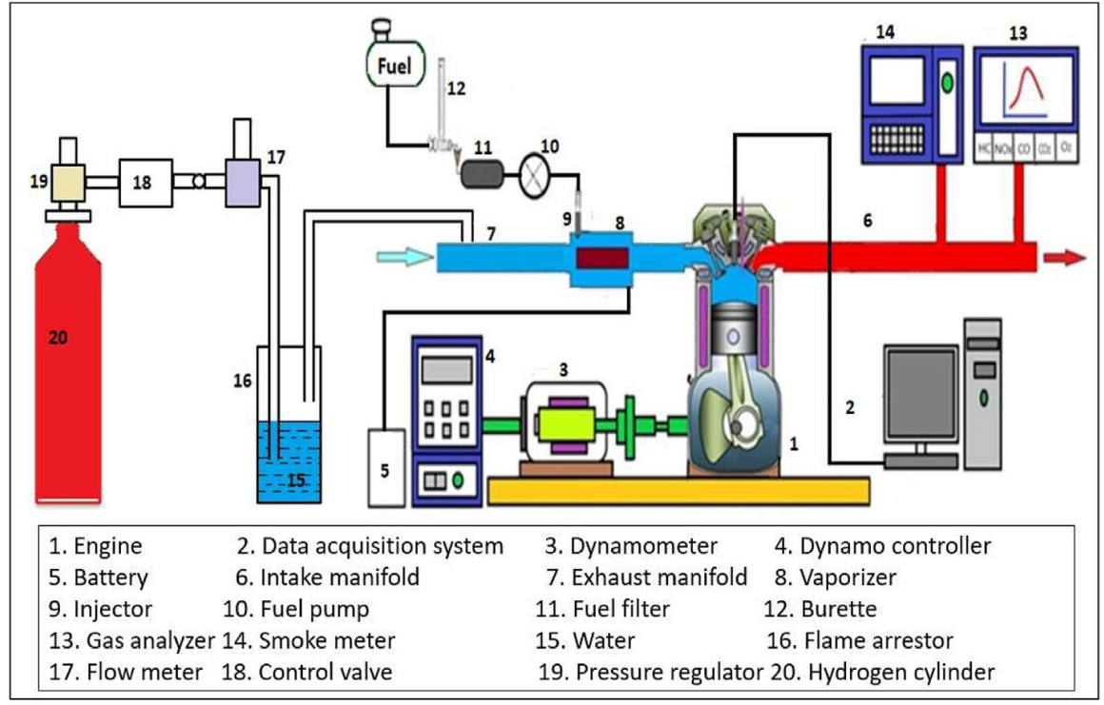

The main advantage is that it reduces both NOx and smoke which is a major issue in normal diesel engine combustion. These developments over the years are promising as reflected in the journal papers and other scientific literature
Fig. Lemon Grass
Fig. Schematic of HCCI engine setup

Slide 6
LITERATURE SURVEY :
S.NO | TITLE | AUTHOR | OUTCOME OF THE PAPER
1. | The performance and emission aspect of the HCCI engine | Mofijur et al 2019 | the HCCI engine offers relatively faster combustion than the CI engine and higher brake thermal efficiency. They observed that various alternative fuels and renewable fuels can be effectively used in HCCI combustion.
2. | The HCCI engine load limit for three different fuels i.e. natural gas, ethanol and methanol | Gharehghani 2019 | The results showed that natural gas was the best fuel at high load HCCI combustion for high inlet temperature, whereas methanol and ethanol was suitable fuels at low load HCCI combustion and low inlet temperature condition
3. | Investigate engine performance for varying fraction of LPG under different torque | Anye Ngang and ngayihi abbe 2020 | This study reveals that increase in LPG fraction improved engine performance in terms of efficiency, power and engine torque as well as reduced NOX and HC emissions.

Slide 7
S.NO | TITLE | AUTHOR | OUTCOME OF THE PAPER
4. | Emission and performance behavior of blends of lemongrass oil | M.A. Asokan 2021 | Very less emission than diesel fuel this will helps the environment cleaning and also proves that LGO is best alternative fuel in Diesel engine in future.
5. | engine performance and emission characteristics fueled with lemon grass oil | S. Ganesan 2021 | It was observed that the reduction of 10.5% in HC emissions and about 17% reduction in the emissions CO for the B20 blend with a decrease of 2.7% in NOx emission at full load.
6. | effects on HCCl combustion at different compression ratios by fusel oil | Somalz 2020 | The compression ratio has a significant effect on the combustion of HCCI, and also it can be used to control the combustion phase of low and high reactivity blended fuels

Slide 8
S.NO | TITLE | AUTHOR | OUTCOME OF THE PAPER
7. | Characteristics of biodiesels in HCCI engine | Euglena Sanguinea 2021 | Biodiesel is a renewable in nature and eco-friendly fuel. The biodiesel has great potential to replace fossil fuel and produce lesser emission like CO, HC and smoke than diesel. It is good for CI engine but produces higher NOx emissions.
8. | studied biogas/diesel powered HCCI combustion | Swami et al. 2021 | The thermal efficiency near to diesel engine values can be achieved. At all times, the NOx range was obtained very low. The best energy to weight ratio was 50%. HC levels were extremely high and were reduced when the charge temperature was increased.
9. | Influence of biodiesel on HCCI engine combustion, performance, and emission characteristics. | Singh et al 2021 | the combustion outcomes for biodiesel HCCI were shown to be more stable compared to diesel HCCI. When the biodiesel content in the test fuel was increased, it resulted in a decrease in power output and a rise in specific fuel consumption.

Slide 9
PROBLEM STATEMENT:
Global warming and air pollution are major consequences of our current society.
The world’s vehicle population is growing rapidly; the automotive industry’s growth rate in India is one of the highest in the world.
In recent times crude oil depletion and emission norms are the main challenges to automotive industries. In upcoming days crude oil may going to extinct.
Various combustion techniques have been used to reduce engine emissions and alternative fuels have been tried as replacement for crude oil in IC engine.

Slide 10
PLAN OF ACTION:
In this investigation we will be following below steps:
Research on different features of lemon grass oil with HCCI engine at which better performance and emissions are resulted.
By adding lemon grass oil (B20) in various proportions to the HCCI engine by varying H2 like 3 LPM,6 LPM and 9 LPM. Studying the combustion of the engine with lower emissions than diesel or not.
We are trying to lower the NOx emissions ,HC and soot and trying increase of engine efficiency .

Slide 11
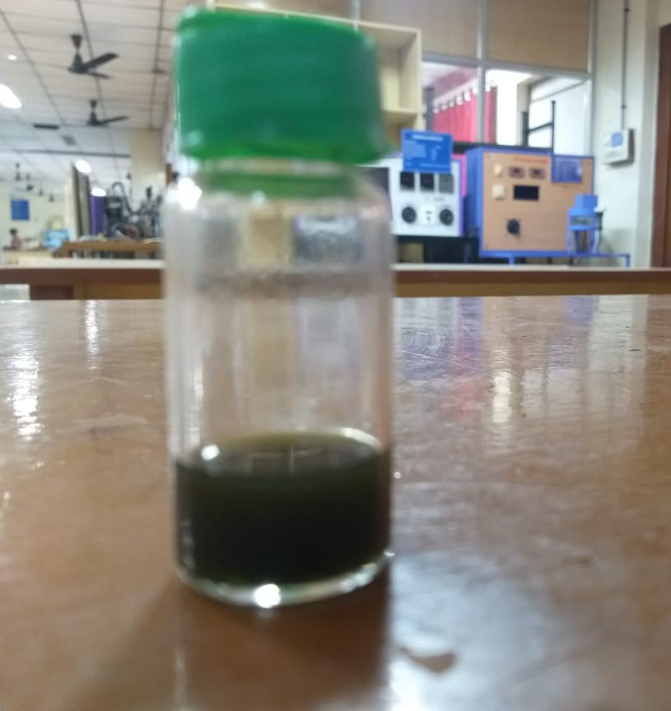
EXPERIMENTATION
SAMPLE PREPARATION FOR TEST :
3drop of biodiesel into 1mg of nanoparticle.
Mix it thoroughly with glass rod.
Take 5ml ethanol.
Add the above mixture into ethanol.
Sonicated the ethanol mixture for dissolve by 5min.
Check the transparency of the mixture sample.
Fig. Blend
Tuesday, September 17, 2024

Slide 12
TESTS PERFORMED ON THE SAMPLE :
The following tests were performed by the Equipments in SRM university, Chennai .
Fourier Transform Infrared Spectroscopy (FTIR)
Gas Chromatography – Mass Spectrometry (GCMS)
Ultra Violet – Visible Spectroscopy (UV-Vis)
Tuesday, September 17, 2024

Slide 13
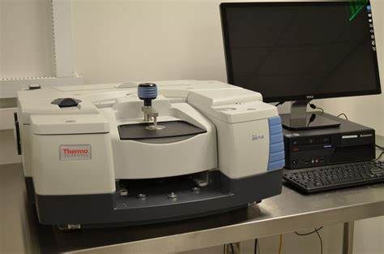
EXPERIMENTAL TECHNIQUES:
Fourier Transform Infrared Spectroscopy (FTIR) shows the Fourier Transform Infrared spectroscopy of neat lemongrass oil, which detects various characteristic functional groups present in the oil. The chemical bond will stretch, contract and absorb infrared radiation in a particular wavelength range during the interaction of an infrared light with the oil.
FTIR spectra were recorded using a series FTIR spectroscopy to produce the IR spectra of the given oil sample. The FTIR spectrum has absorption bands in the region 4500–500 cm .The peak absorption of OH group indicated that phenolic compounds appeared at a frequency of 2887 cm .
The remaining peaks is CH, C=O, COOH etc.… but as for experimental purpose. We required OH group only.
-1
-1
-1
Tuesday, September 17, 2024
Fig. FTIR

Slide 14
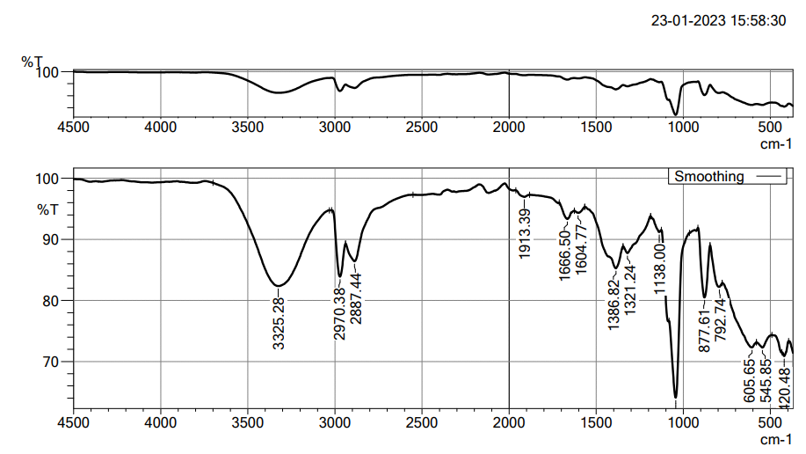
Fourier Transform Infrared Spectroscopy (FTIR) :
Fig. FTIR Graph
Tuesday, September 17, 2024

Slide 15
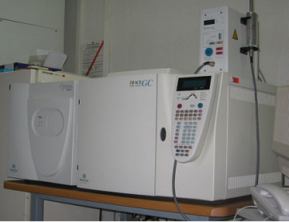
Gas Chromatography – Mass Spectrometry (GCMS):
The GCMS instrument and the tests can be used as an analytical tool to quantify the chemical components present in the bunker fuels. The tests are usually done as per ASTM 7845 – Standard Test Method for Determination of Chemical Species in Lemon grass Oil by Multidimensional Gas Chromatography – Mass Spectrometry.
Fig. GC-MS
Tuesday, September 17, 2024

Slide 16
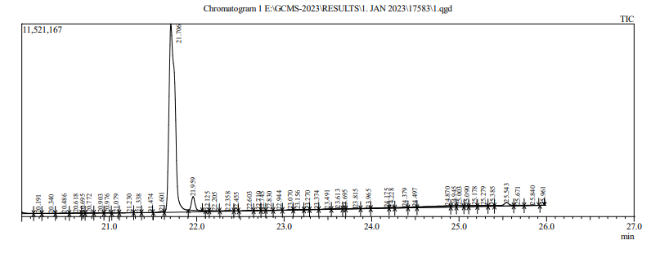
Gas Chromatography – Mass Spectrometry (GCMS):
Fig. GC-MS Graph
From these three graphs we observed on X-axis time in minutes and on Y-axis spectrum.
Based on these graphs, there are totally 208 chemical compounds is observed in the oil sample. Each sample has different chemical name and properties.
Tuesday, September 17, 2024

Slide 17
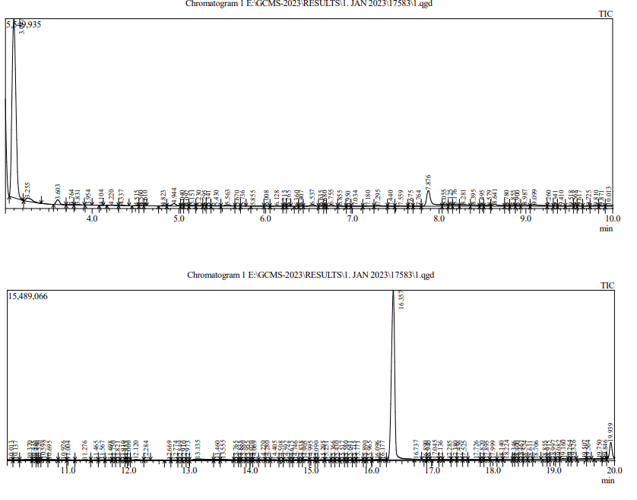
Gas Chromatography – Mass Spectrometry (GCMS):
Fig. GC-MS Graph
Fig. GC-MS Graph
Tuesday, September 17, 2024

Slide 18
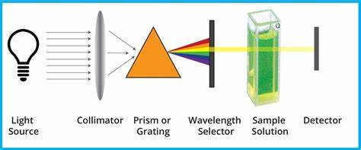
Ultra Violet – Visible Spectroscopy (UV-Vis)
UV-Vis Spectroscopy (or Spectrophotometry) is a quantitative technique used to measure how much a chemical substance absorbs light. This is done by measuring the intensity of light that passes through a sample with respect to the intensity of light through a reference sample or blank.
Fig. UV-VIS
Tuesday, September 17, 2024

Slide 19
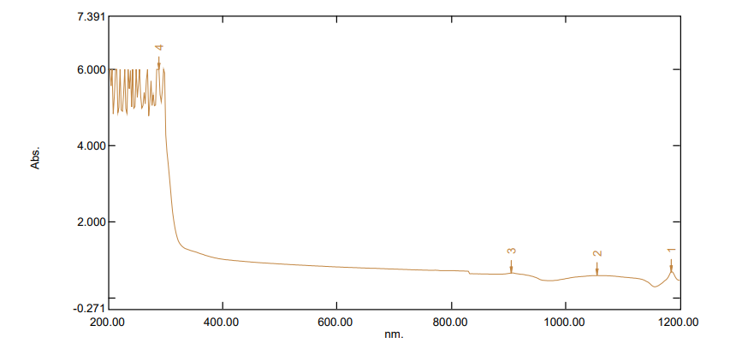
Ultra Violet – Visible Spectroscopy (UV-Vis) :
Fig. UV-Vis Graph
The graph on X- axis wavelength (nm) and on Y- axis absorbance (%). The graph is shown here from 200 to 1200 nm.
Due to nano particles the graph is at peak stage from 200 to 300 nm ( That region should called as UV- region)
From 300 nm to 800 nm the graph is decreased the region is called visible region. After 800 nm, it is Infrared region.
Tuesday, September 17, 2024

Slide 20
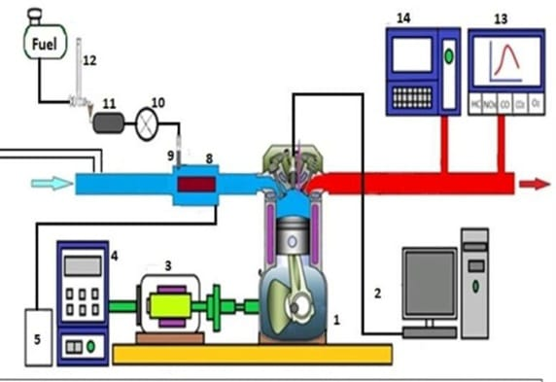
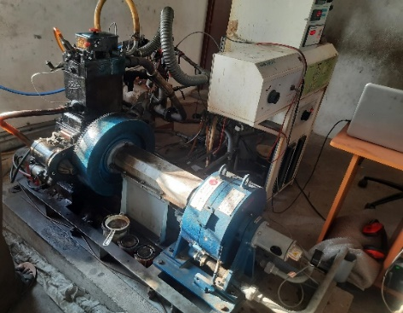

EXPERIMENTAL SETUP
S.no | Engine parameters | Specifications
1 | Number of cylinders | 1
2 | No. of strokes | 4
3 | Rated Power | 5.2 kW
4 | Rated speed | 1500 RPM
5 | Cylinder diameter | 87.5mm
6 | Stroke length | 110mm
7 | Compression ratio | 17.5:1
8 | Orifice diameter | 20mm
9 | Dynamometer arm length | 185mm
6
Engine 2. Data acquisition system 3. Dynamometer 4. Dynamo controller
5. Battery 6.Intake Manifold 7. Exhaust Manifold 8.Vaporizer
9. Injector 10. Fuel Pump 11.Fuel filter 12.Burette
13. Gas analyser 14.Smoke Meter
Fig. Engine Specifications
Fig. HCCI Engine
Fig. Making Note at WorkSpace
Tuesday, September 17, 2024

Slide 21
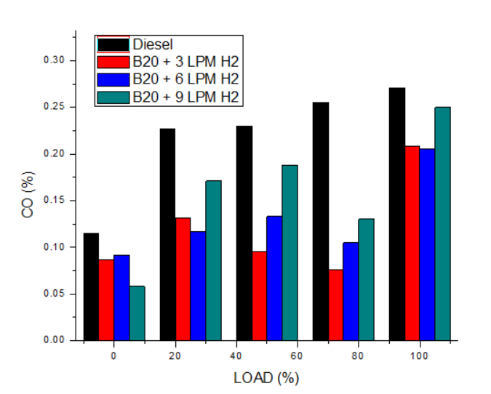
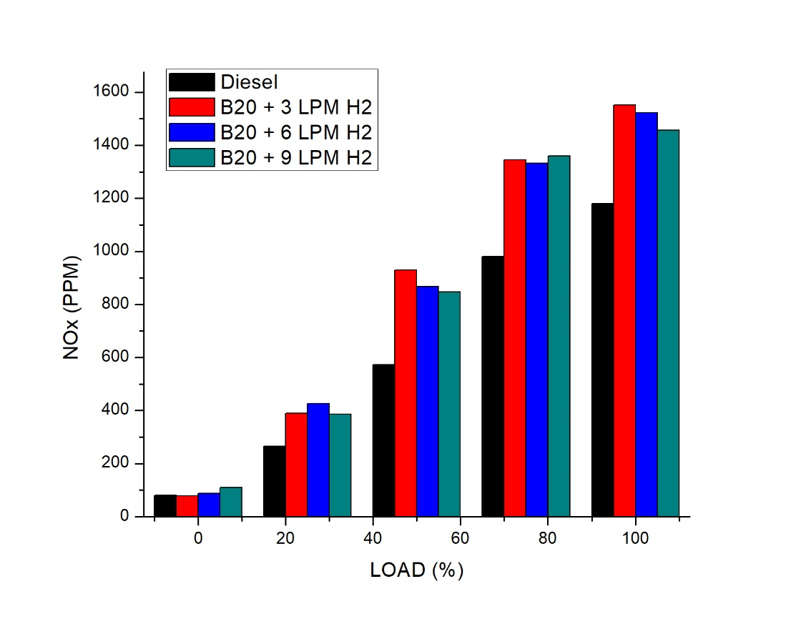
RESULTS:
Emmission Results :
CO emission NOx emission
The percentage of reduction in CO for the B20 + 3 LPM H2 , B20 + 6 LPM H2, B20 + 9 LPM H2 is 23.44 % ,23.24 % and 7.7% (when compared to base fuel).
The percentage of increased in NOx for the B20 + 3 LPM H2 , B20 + 6 LPM H2, B20 + 9 LPM H2 is when compared to base fuel is 6.80%, 12.54% and 5.7%
Tuesday, September 17, 2024

Slide 22
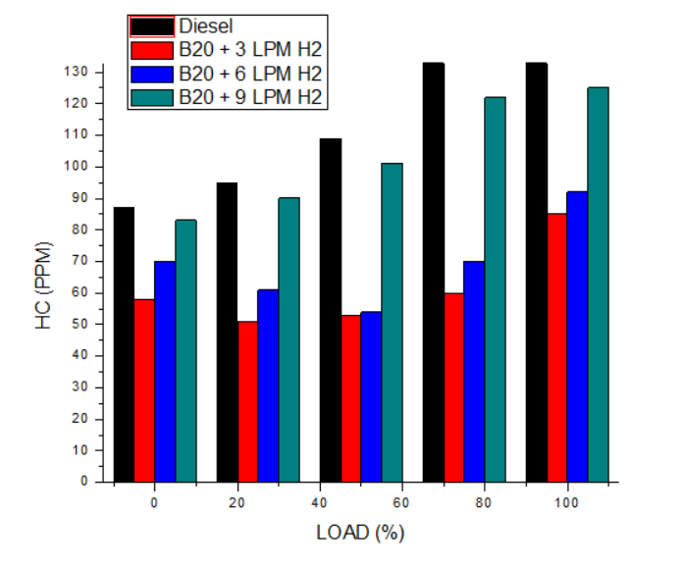
HC emission
The percentage of reduction in HC for the B20 + 3 LPM H2 , B20 + 6 LPM H2, B20 + 9 LPM H2 is 33.56%, 30.76% and 12.58% ( when compared to base fuel ).
Tuesday, September 17, 2024

Slide 23
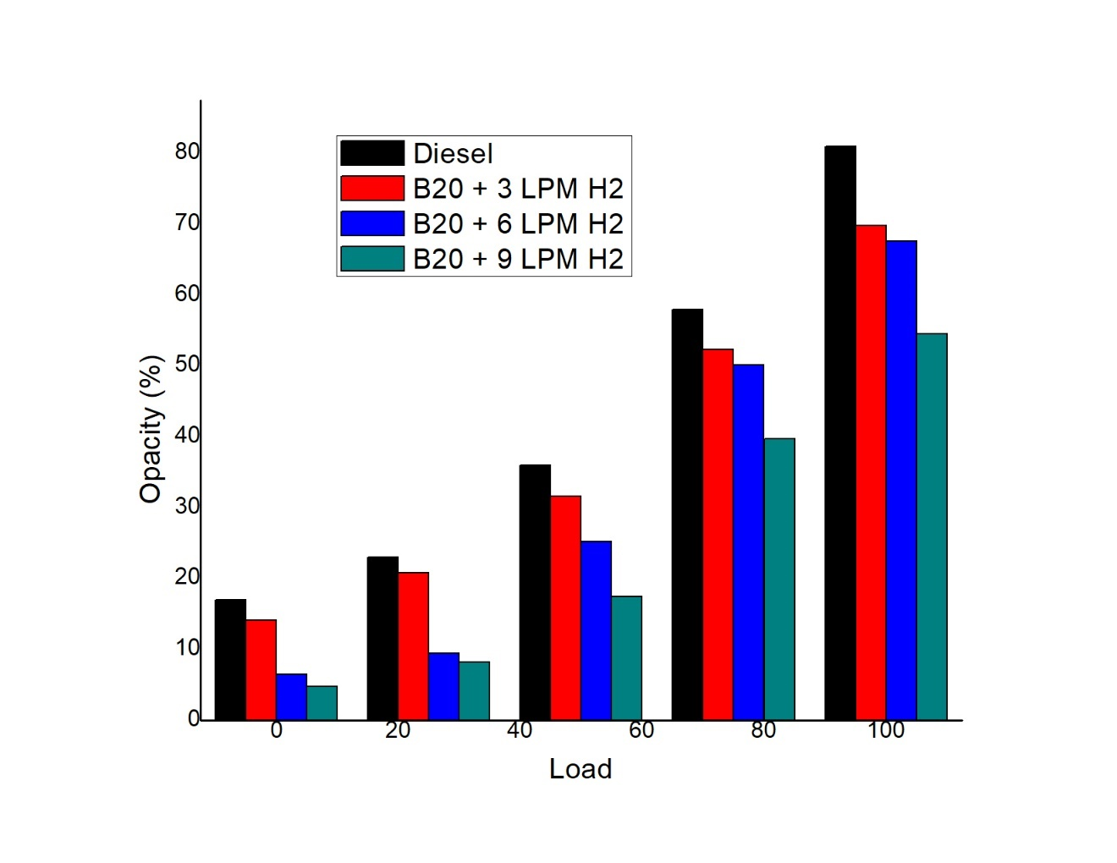
According to the results, diesel operation discharges more amounts of smoke emissions when compared to the LGO blends. LGO B20 gives a maximum reduction of smoke compared to the other fuel samples. LGO B20 showed 21.02% lower smoke percentage of diesel.

Slide 24
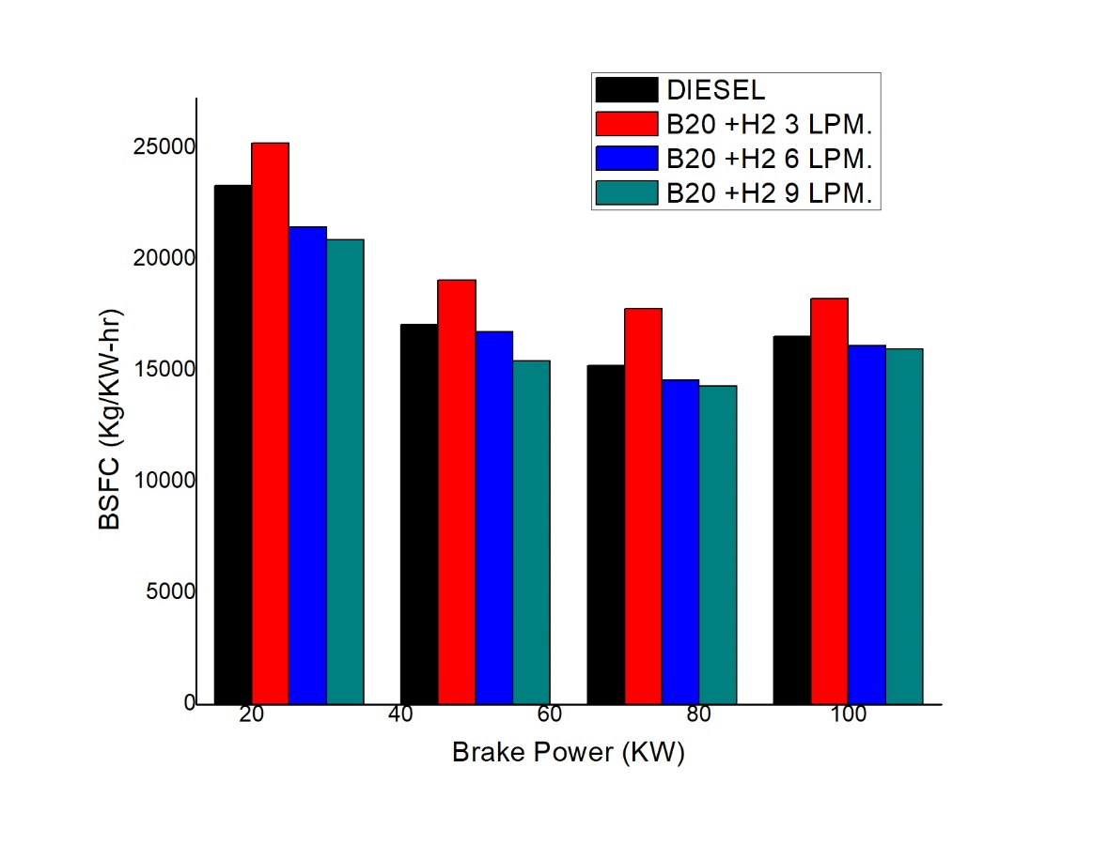
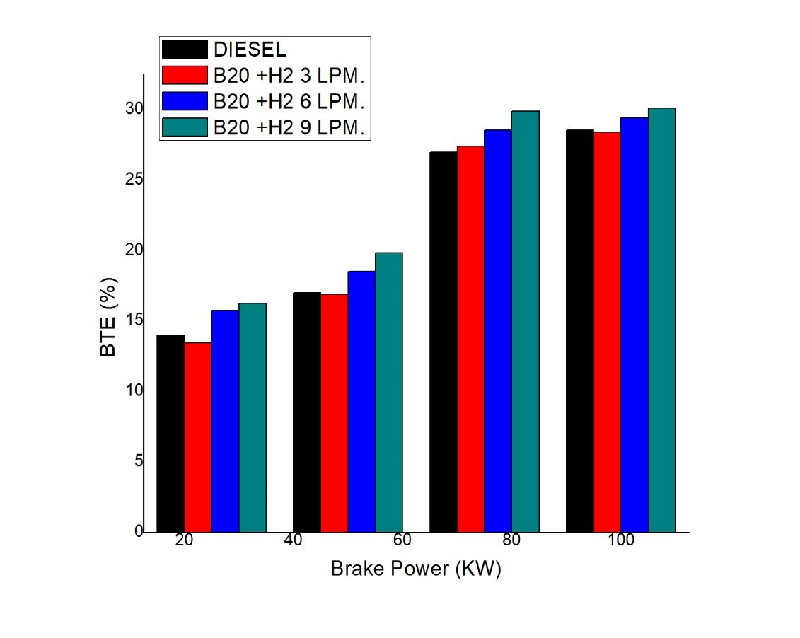
RESULTS:
Performance Results:
The graph shows that the LGO B20 has high BSFC than diesel when operated at 3 LPM H2 at all loads. The LGO B20 H2 6 LPM and LGO B20 H2 9 LPM has less BSFC compared to remaining at all loads because of proper atomization and mixing of fuel air mixture before start of combustion. The decreasing BSFC percentage of LGO B20 + 6 LPM and LGO B20+ H2 9 LPM is 2.54% and 3.36% when compared to base fuel.
The LGO B20 H2 6 LPM exhibits higher BTE only at higher loads and the LGO B20 +H2 3 LPM has lower BTE compared to diesel at all loads. The increasing percentage of BTE for LGO B20+ H2 6LPM and LGO B20+ H2 9LPM is 3.18% and 5.53%, due to some oxygen content available in the biodiesel it makes proper combustion take places.
Tuesday, September 17, 2024

Slide 25
CONCLUSION
The following conclusions are drawn by conducting the experiment and studied the effect of varying injection pressure on performance and emission characteristics of Homogeneous Charge Compression Ignition (HCCI) engine operated by using biodiesel (20% lemon grass oil biodiesel + 80% diesel) and hydrogen gas.
The percentage of reduction in CO for the B20 + 3 LPM H2 , B20 + 6 LPM H2, B20 + 9 LPM H2 is 23.44 % ,23.24 % and 7.7% (when compared to base fuel).
The percentage of increased in NOx for the B20 + 3 LPM H2 , B20 + 6 LPM H2, B20 + 9 LPM H2 is when compared to base fuel is 6.80%, 12.54% and 5.7%
The percentage of reduction in HC for the B20 + 3 LPM H2 , B20 + 6 LPM H2, B20 + 9 LPM H2 is 33.56%, 30.76% and 12.58% ( when compared to base fuel ).
According to the results, diesel operation discharges more amounts of smoke emissions when compared to the LGO blends. LGO B20 gives a maximum reduction of smoke compared to the other fuel samples. LGO B20 showed 21.02% lower smoke percentage of diesel.
The LGO B20 H2 6 LPM exhibits higher BTE only at higher loads and the LGO B20 +H2 3 LPM has lower BTE compared to diesel at all loads. The increasing percentage of BTE for LGO B20+ H2 6LPM and LGO B20+ H2 9LPM is 3.18% and 5.53%.
The decreasing BSFC percentage of LGO B20 + 6 LPM and LGO B20+ H2 9 LPM is 2.54% and 3.36% when compared to base fuel.

Slide 26
THANK YOU
Tuesday, September 17, 2024

